Slide 1

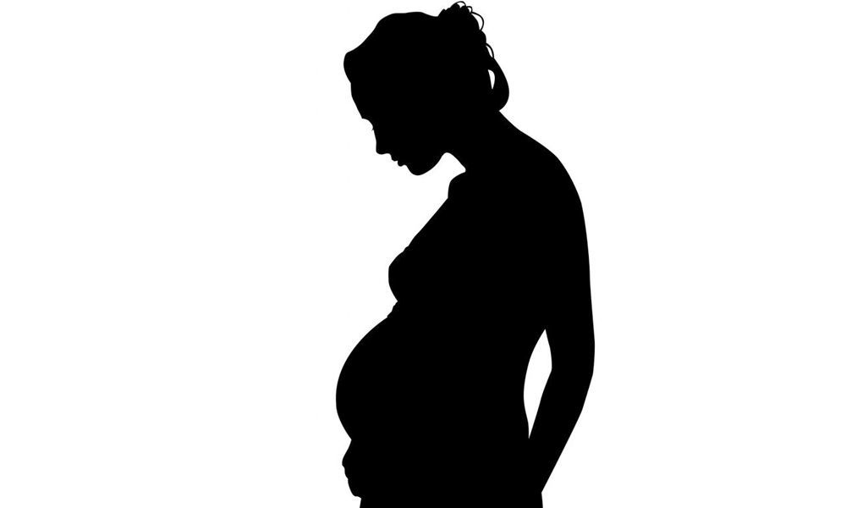
Revisiting the burden of TB in pregnant and post-partum women
Nyashadzaishe Mafirakureva, Pete Dodd

Slide 2

Background
TB is the leading infectious disease killer, above HIV/AIDS
HIV/AIDs & pregnancy/postpartum increase risk of TB
maternal TB associated with negative outcomes (mortality, unfavourable pregnancy outcomes, infant TB)
Limited evidence on the risk & burden of TB in pregnancy/postpartum
Unclear risk/benefit trade-off of IPT during pregnancy/postpartum
WHO Global TB report 2018, Bates et al. 2015, Getahun et al. 2012
Notes:
global predominance of TB in men
well documented higher prevalence of HIV in young women

Slide 3

Burden of TB during pregnancy
sparse data regarding TB during pregnancy and postpartum
most countries do not systematically collect data on TB
the burden of TB in pregnant women is substantial
prevalence
review of available data
0.06% to 0.25% in low-burden countries
0.07% to 0.5% HIV-negative women in high-burden countries
0.7% to 11% HIV-positive women in high-burden countries
epidemiological modelling study
210 per 100,000 pregnant women globally in 2011 (95% confidence interval [CI] 180–240)
Odayar et al. 2018, Sugarman et al. 2014, Mathad & Gupta 2012

Slide 4

Objectives
to perform a rapid review and meta-analysis of the data available in order to quantify the risk of TB during pregnancy and postpartum
to estimate the global and country-level burden of TB disease among pregnant and post-partum women
to estimate the RISK-adjusted global and country-level burden of TB disease among pregnant and post-partum women

Slide 5

Rapid Review & Meta-analysis
Participants/population
Women of child bearing age.
Exposure(s)
Pregnancy; postpartum.
Comparator(s)/control
Non pregnant/ postpartum women.
Outcome
IRR for tuberculosis
PROSPERO 2018,
CRD42018111690

Slide 6

Rapid Review & Meta-analysis
Medline and EMBASE via OVID without date or language restrictions
intersection of terms relating to ‘pregnancy or postpartum’, ‘tuberculosis’, and ‘observational study’
Studies included
longitudinal studies of TB incidence (IRR)
cross-sectional studies of TB prevalence (OR)
cross-sectional studies of the prevalence of pregnancy/postpartum (OR)
quality assessed using NIH’s Quality Assessment Tool for Observational Cohort and Cross-Sectional Studies
Random effects meta-analysis
sub-group analyses
Notes:
In all study types relevant control groups were required for estimation of IRR or ORs

Slide 7

Data Collection
Study characteristics
First author, year, country, journal of publication, study type, population, exposures, controls
Sample demographics
Age
Sample characteristics
HIV status
Outcome data
Active TB cases, IRR, OR

Slide 8

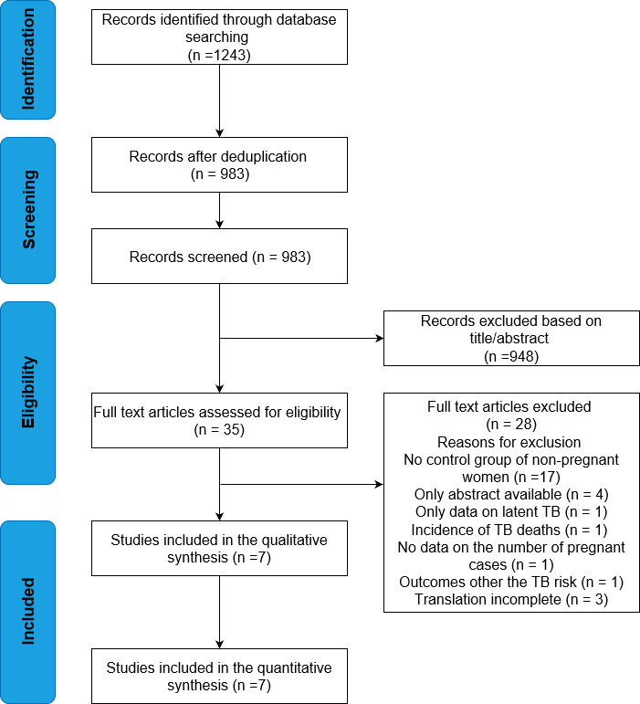
Flow diagram of identification, screening and inclusion of studies

Slide 9
First author, year | Study years | Country | Population, setting | Study type | Control type | HIV status | Mean age and SD/range | TB case definition | Postpartum definition | Quality assessment
Bothamley, 2016 | 2008-2013 | Europe and the USA | All patients with TB seen at 13 different clinics | Cross sectional survey | None given | No data given | No data given | No data given | 3 months | Poor
Crampin, 2004 | 1996-2001 | Malawi | TB patients of both genders identified via “enhanced passive surveillance” | Case control | Field based random sampling of the community | Cases: 32%- 68%+ Control: 86%- 14%+ | No data given | Positive smear, culture or biopsy | 6 months | Poor
Espinal, 1996 | 1992-1994 | Dominican Republic | Women aged 15-44 with newly diagnosed active TB seen at 4 different facilities | Case control | Recruited at the National Laboratory of Public Health when they presented for anon HIV testing | No data given | No data given | Must have all of: typical signs and symptoms of TB, >1 smear of resp tract secretions + for AFB, no history of prior TB | NA | Fair
Odayar, 2018 | 2013-2014 | South Africa | Women at a large public sector primary health care facility, HIV+ women during pregnancy or postpartum | Retrospective cohort study | None given | All + | 29 at enrolment IQR 26-33 | Positive sputum smear microscopy, TB culture, CXR abnormalities consistent with TB | 6 months | Good
Rendell, 2016 | 2013 | Mongolia | Data collected on pregnant women diagnosed from TB from central TB dispensaries | Retrospective case study | None given | <0.1% + | Pregnant women with TB: 27 (SD +/- 5.6, range 18-43) | Based on microbiological results or symptoms and CXR findings | NA | Fair
Zenner, 2012 | 1996-2008 | United Kingdom | All women with pregnancies that occur within the time period studies | Cohort study | Self-controlled case series | No data given | At pregnancy: 29.5 (range 13-50) | Positive sputum culture, presence of clinical/radiological signs, symptoms | 6 months | Good
Title goes here

Slide 10

Risk of BIAS assessment
Studies | Study design | Selection | Confounding | Measurement of exposure | Measurement of outcomes | Study-level RoB Judgement
Crampin 2004 | Case control | NoYesNoNo | Yes | NoNRYesYesNo | NRYesNoNR | Poor
Bothamley 2016 | Cross-sectional | YesNoNoNo | No | NoNRYesYesNo | NRNRNoNR | Poor
Espinal 1996 | Case control | YesYesYesNo | No | NoNRYesYesNo | NRYesNoNR | Fair
Odayar 2018 | Retrospective cohort | YesYesYesNo | Yes | YesNRYesYesNo | NRYesNoNR | Good
Rendell 2016 | Retrospective case-control | YesYesYesNo | No | NoNRNoYesNo | NRYesNoNR | Fair
Zenner 2012 | Retrospective cohort | YesYesYesYes | Yes | YesYesYesYesNo | YesYesNoNR | Good
Low | Moderate | Serious | Critical
Notes:
Domain and relevant questions from the NIH tool
Selection – 2,3,4,5
study population clearly specified and defined?
participation rate of eligible persons at least 50%?
subjects selected or recruited from the same or similar populations (including the same time period)? inclusion and exclusion criteria pre-specified and applied uniformly?
sample size justification, power description
Confounding – 14
potential confounding variables measured and adjusted statistically for their impact on the relationship between exposure(s) and outcome(s)?
Measurement of exposure – 6, 7, 8, 9, 10
exposure(s) of interest measured prior to the outcome(s) being measured?
timeframe sufficient to see an association between exposure and outcome?
different levels of the exposure as related to the outcome defined?
exposure measures clearly defined, valid, reliable, and implemented consistently across all study participants?
exposure(s) assessed more than once over time?
Measurement of outcome – 7, 11, 12, 13
timeframe sufficient to see an association between exposure and outcome?
outcome measures clearly defined, valid, reliable, and implemented consistently across all study participants?
outcome assessors blinded to the exposure status of participants?
loss to follow-up after baseline 20% or less?

Slide 11
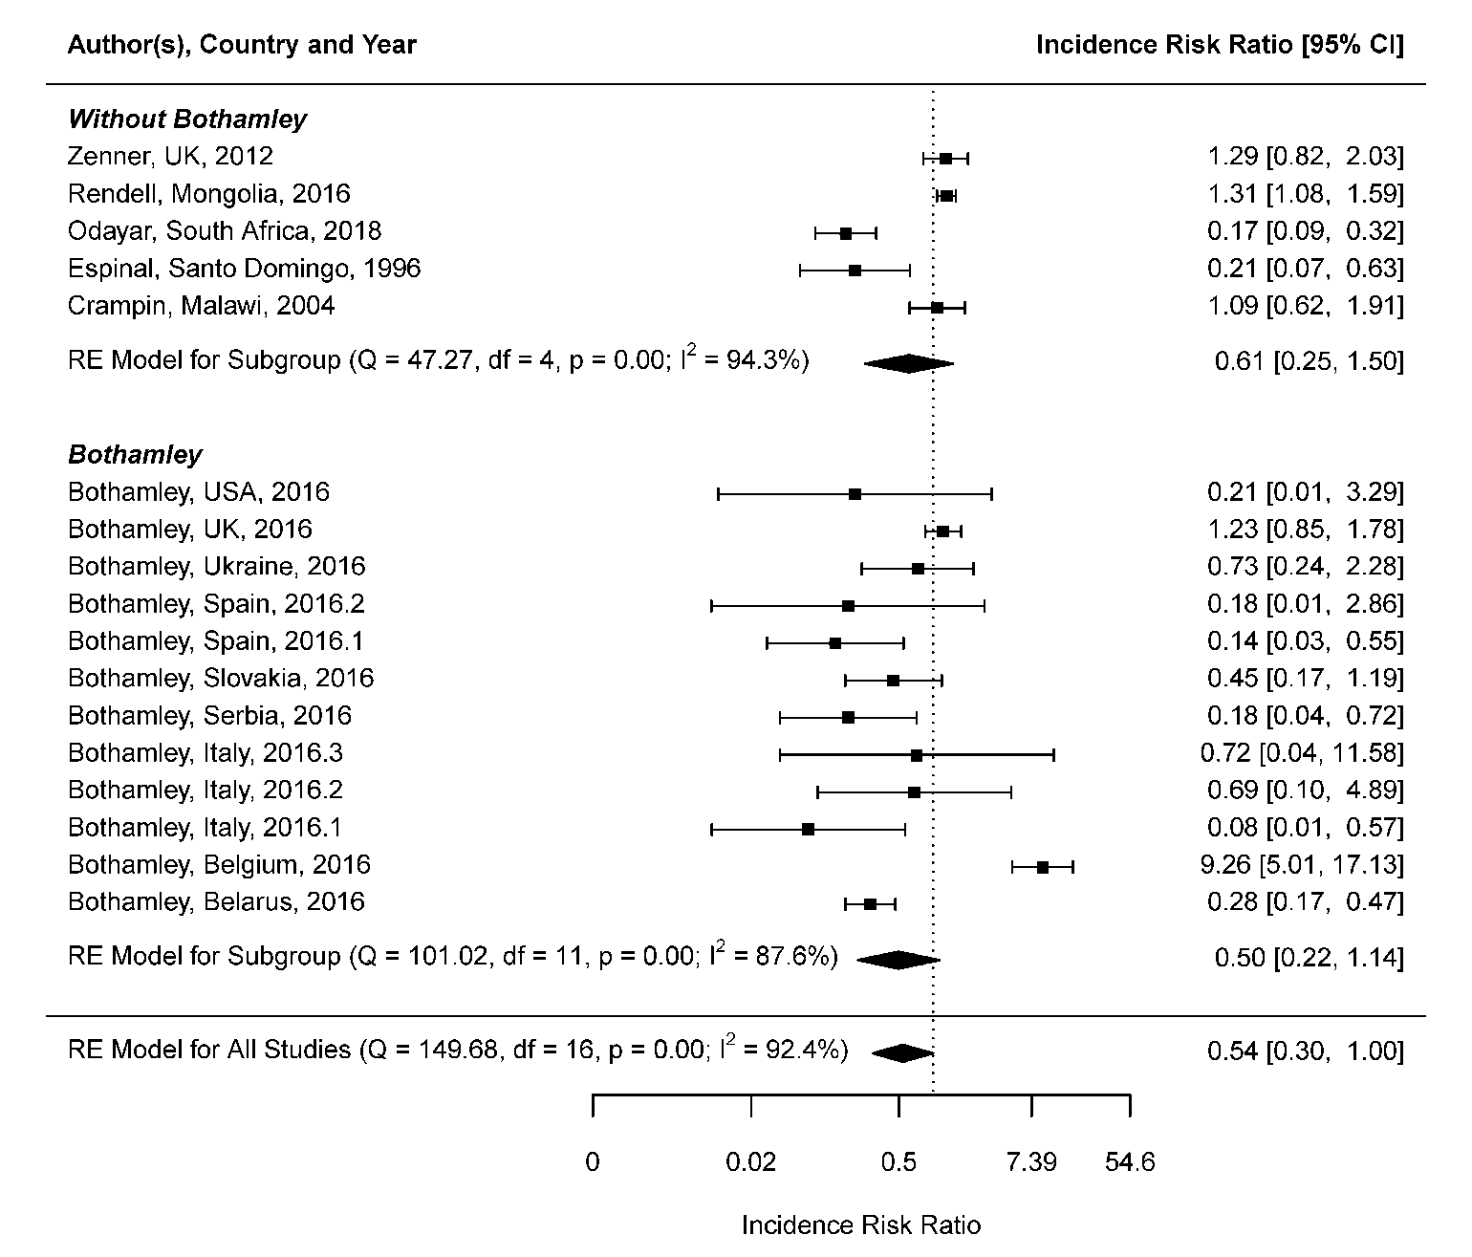
Risk of TB during pregnancy
Notes:
Domain and relevant questions from the NIH tool
Selection – 2,3,4,5
study population clearly specified and defined?
participation rate of eligible persons at least 50%?
subjects selected or recruited from the same or similar populations (including the same time period)? inclusion and exclusion criteria pre-specified and applied uniformly?
sample size justification, power description
Confounding – 14
potential confounding variables measured and adjusted statistically for their impact on the relationship between exposure(s) and outcome(s)?
Measurement of exposure – 6, 7, 8, 9, 10
exposure(s) of interest measured prior to the outcome(s) being measured?
timeframe sufficient to see an association between exposure and outcome?
different levels of the exposure as related to the outcome defined?
exposure measures clearly defined, valid, reliable, and implemented consistently across all study participants?
exposure(s) assessed more than once over time?
Measurement of outcome – 7, 11, 12, 13
timeframe sufficient to see an association between exposure and outcome?
outcome measures clearly defined, valid, reliable, and implemented consistently across all study participants?
outcome assessors blinded to the exposure status of participants?
loss to follow-up after baseline 20% or less?

Slide 12
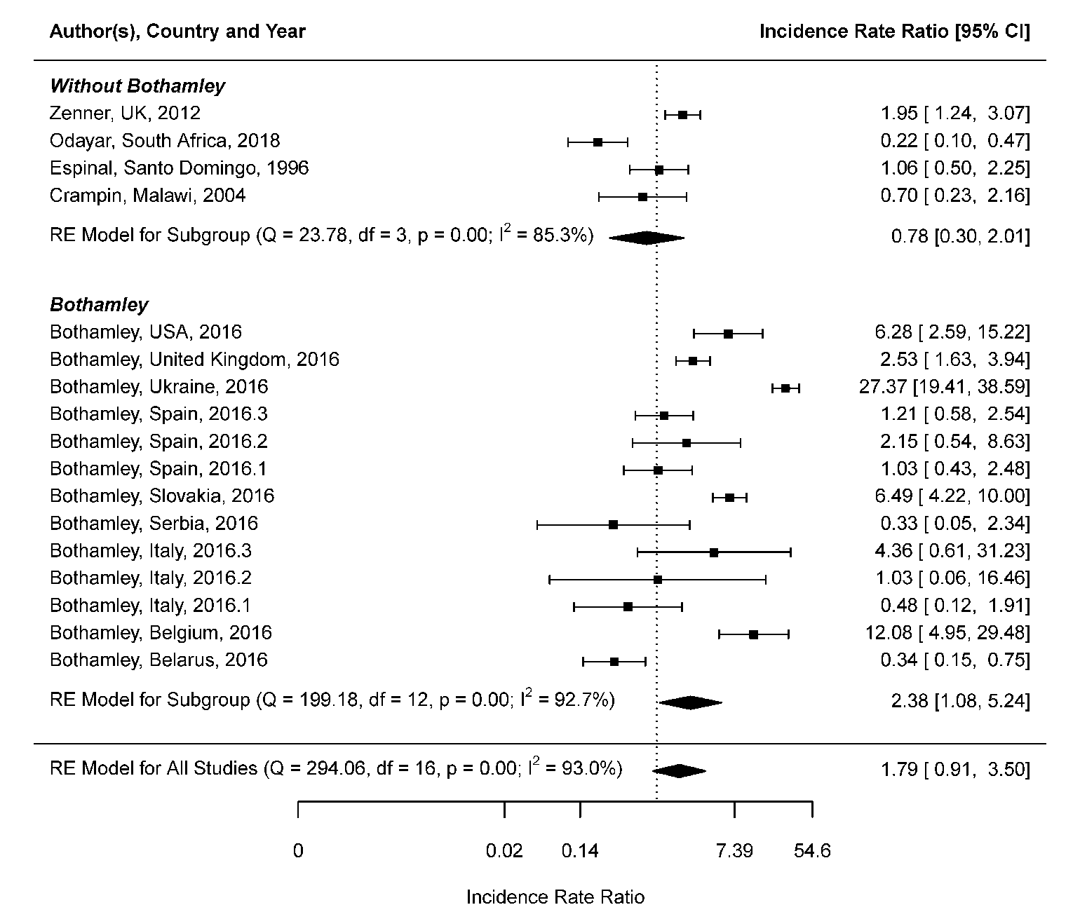
Risk of TB during postpartum
Notes:
Domain and relevant questions from the NIH tool
Selection – 2,3,4,5
study population clearly specified and defined?
participation rate of eligible persons at least 50%?
subjects selected or recruited from the same or similar populations (including the same time period)? inclusion and exclusion criteria pre-specified and applied uniformly?
sample size justification, power description
Confounding – 14
potential confounding variables measured and adjusted statistically for their impact on the relationship between exposure(s) and outcome(s)?
Measurement of exposure – 6, 7, 8, 9, 10
exposure(s) of interest measured prior to the outcome(s) being measured?
timeframe sufficient to see an association between exposure and outcome?
different levels of the exposure as related to the outcome defined?
exposure measures clearly defined, valid, reliable, and implemented consistently across all study participants?
exposure(s) assessed more than once over time?
Measurement of outcome – 7, 11, 12, 13
timeframe sufficient to see an association between exposure and outcome?
outcome measures clearly defined, valid, reliable, and implemented consistently across all study participants?
outcome assessors blinded to the exposure status of participants?
loss to follow-up after baseline 20% or less?

Slide 13

Estimation of burden of TB disease among pregnant and post-partum women

Slide 14

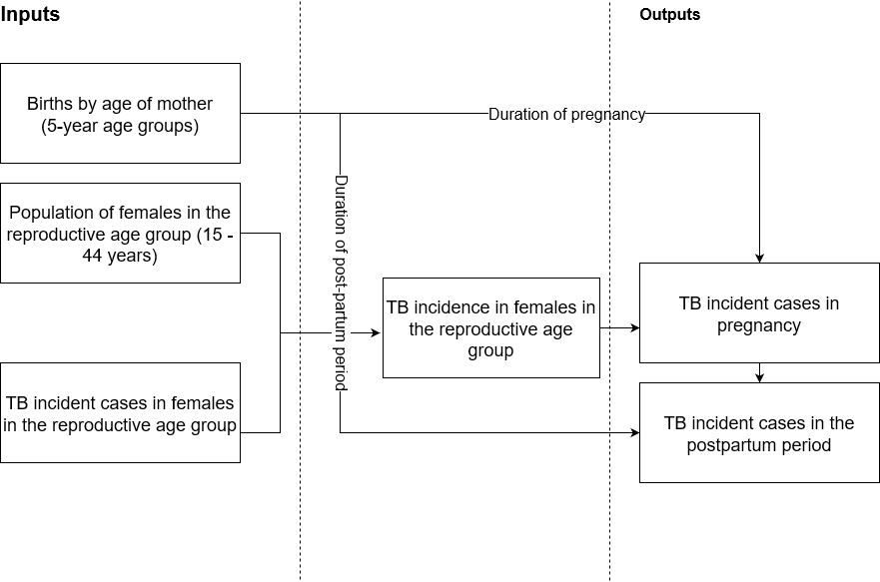
The approach

Slide 15



Estimation
$$Estimated incident TB cases during pregnancy=\frac{Births x incident TB cases(age 15–44 years) x 280/365}{Population women age 15–44 years }$$
$$Estimated incident TB cases during postpartum=\frac{Births x incident TB cases(age 15–44 years) x 90/365}{Population women age 15–44 years}$$

Slide 16
Global burden of TB disease

Slide 17
Global burden of TB disease during pregnancy

